Slide 1

Reproduction and Genetics Centre
Moscow
Sergeev S.A.
Development of a machine learning model based on DNN neural networks for estimating pregnancy probability

Slide 2
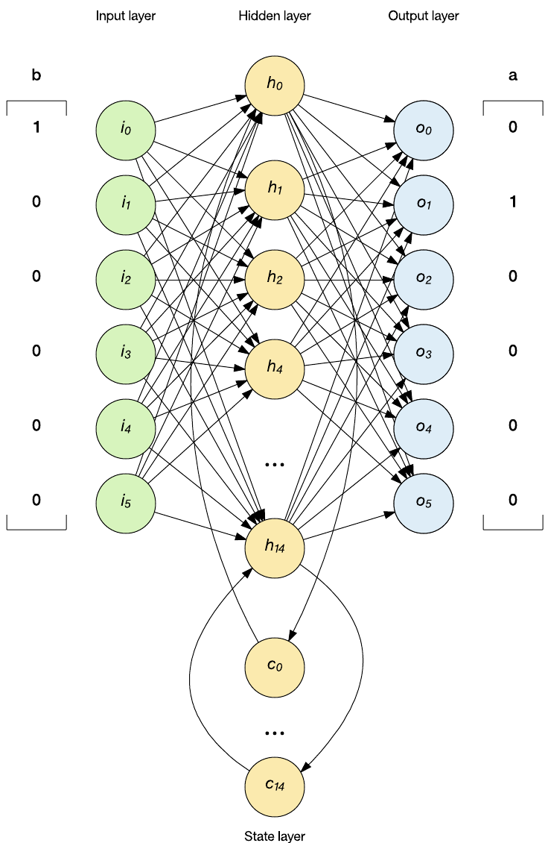
Deep learning neural networks (DNNs)
DNNs are powerful tools for data analysis, prediction and process automation.
Their efficiency depends on the quality of data, the choice of network architecture and optimisation of the training process.
Neural networks consist of a set of interconnected nodes called neurons. They are organised into layers: input layer, hidden layers and output layer. The input layer receives data, the hidden layers perform computations, and the output layer provides results or predictions. Each neuron is connected to neurons in the next layer using weights that determine the strength of the connection between neurons.
In this way, the neural network finds the correct method of mathematical transformations to turn input data into output data, regardless of their linear or non-linear correlation

Slide 3
Training a neural network
1. Data preparation: Obtaining access to the MIS database in the form of a report, pre-processing and coding the data with division into training, validation and test data sets.
2 Determination of the network architecture: Selection of the neural network structure: number of layers, number of neurons in each layer, types of layers. Definition of activation function, loss function, optimiser and metric for model evaluation.
3. Initialising the model: Creating the model using Python libraries.
4. Model compilation: Build the model according to the defined architecture.
5. Model training: Using training data for model input and appropriate training method. During training, the model updates the weights using error back propagation method to minimise the loss function.
6. Model evaluation: Evaluating the performance of the model on validation data to check its generalisability. Evaluation on test dataset for final evaluation of the model.
7. Fine Tuning and Optimisation: Tune the hyperparameters of the model including learning rate, regularisation and other parameters to improve the performance of the model.

Slide 4
Selection of model parameters and calculation of necessary indicators
Medworks Incoming Data:
"Age", "No. of attempts", "Number of follicles", "Number of OKCs", "Number of inseminated", "2 pN", "Number of embryos on day 3", "Number of Bl", "Number of Bl of good quality"
KPI:
"Fertilisation frequency", "Cleavage D3 frequency", "Blastocyst formation frequency", "Good quality blastocyst formation frequency", "OCC retrieval frequency", "Number of Day 5 embryos", "Embryos frozen", "Transfer day", "Embryos transferred"
KPIScore

Slide 5
Dataset
 | Count | Mean | Std | Min | 25% | 50% | 75% | Max
Age | 3856 | 35.52 | 5.26 | 19 | 32 | 36 | 39 | 56
No. of attempts | 3856 | 2.1 | 1.91 | 0 | 1 | 1 | 3 | 36
Number of follicles | 3856 | 8.86 | 5.95 | 0 | 4 | 8 | 12 | 60
OCC | 3856 | 7.46 | 4.96 | 0 | 4 | 7 | 10 | 46
Number of inseminated | 3856 | 5.74 | 3.96 | 1 | 3 | 5 | 8 | 40
2 pN | 3856 | 4.03 | 2.98 | 0 | 2 | 3 | 6 | 23
Number of D3 | 3856 | 3.95 | 2.92 | 0 | 2 | 3 | 5 | 23
Number of Bl | 3856 | 1.89 | 2.5 | 0 | 0 | 1 | 3 | 17
Number of Bl of good quality | 3856 | 0.89 | 1.53 | 0 | 0 | 0 | 1 | 11
FR | 3856 | 0.73 | 0.25 | 0 | 0.56 | 0.75 | 1 | 2
Cleavage Rate | 3856 | 0.96 | 0.16 | 0 | 1 | 1 | 1 | 1
Bl Rate | 3856 | 0.33 | 0.36 | 0 | 0 | 0.25 | 0.67 | 1
good quality blastocysts rate | 3856 | 0.16 | 0.25 | 0 | 0 | 0 | 0.29 | 1
OCC Rate | 3856 | 0.85 | 0.28 | 0 | 0.75 | 0.9 | 1 | 14
Number of Day 5 embryos | 3856 | 3.17 | 3.51 | 0 | 0 | 2 | 5 | 31
Embryos cryo | 3856 | 1.05 | 1.53 | 0 | 0 | 0 | 2 | 13
ET Day | 3856 | 3.59 | 1.13 | 0 | 3 | 3 | 5 | 7
Embryos transferred | 3856 | 1.45 | 0.58 | 1 | 1 | 1 | 2 | 4
ET outcome | 3856 | 0.38 | 0.49 | 0 | 0 | 0 | 1 | 1
KPIScore | 3856 | 14.93 | 4.62 | 5 | 11 | 15 | 19 | 25

Slide 6
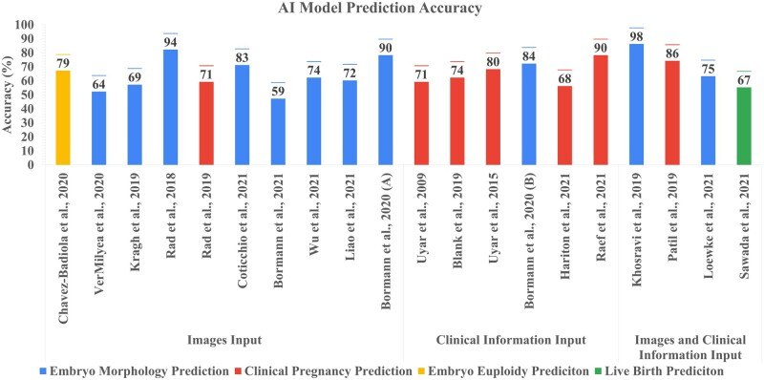
Neural networks and their results in literature data and in a comparison experiment
(Salih et al., 2023. doi: 10.1093/hropen/hoad031)

Slide 7
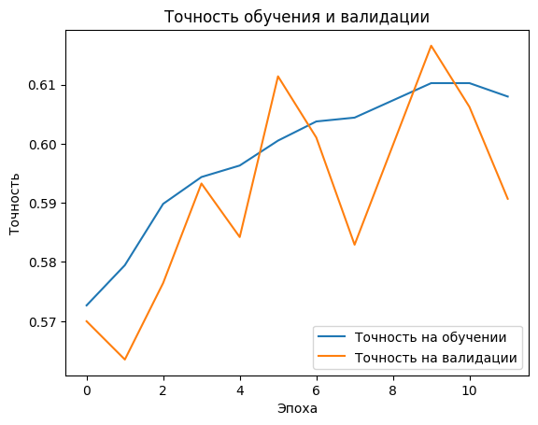
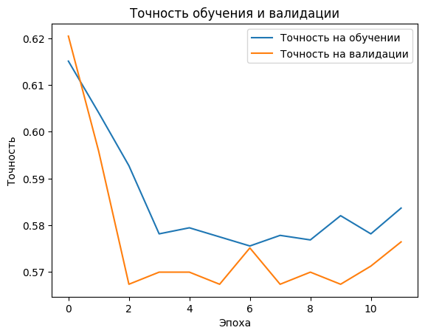
Modelling the learning process from publications
loss: 0.6797 - accuracy: 0.5764
loss: 0.6658 - accuracy: 0.5735
Kaufmann et al., 1997. DOI:10.1093/humrep/12.7.1454
Vogiatzi et al.,2019. doi:10.1007/s10815-019-01498-7
Accuracy of Gradient Boosting model: 0.6243523316062176
Accuracy of Random Forest model on test data: 0.5816062176165803
Decision tree model accuracy on test data: 0.5479274611398963
Lu et al., 2023. doi:10.1186/s12884-023-05775-3

Slide 8
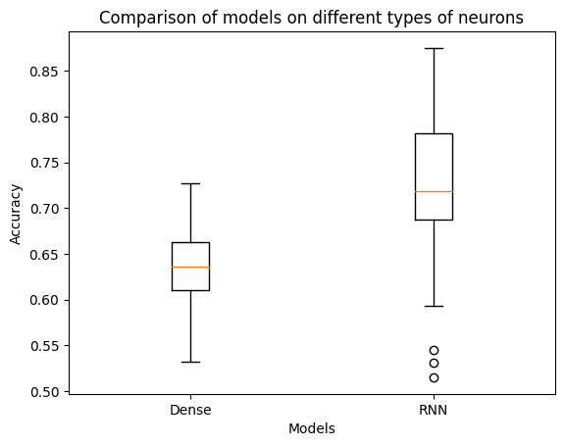
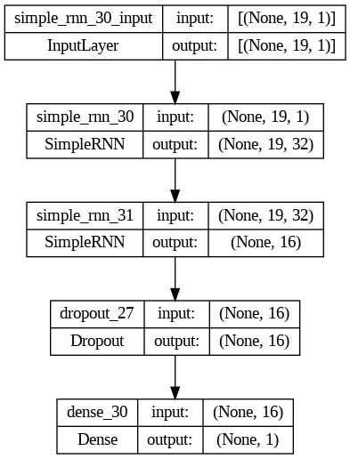
Selection of neuron type and model architecture
t-statistic: -7.055274039431632
p-value: 2.4699782266522906e-10
Average accuracy: 0.636170494556427
Standard deviation of accuracy: 0.041024173481496236
Maximum accuracy: 0.7272727489471436 Minimum accuracy: 0.5324675440788269
Average accuracy: 0.72357954621315
Standard deviation of accuracy: 0.07640754558819807
Maximum accuracy: 0.875
Minimum accuracy: 0.5151515007019043

Slide 9
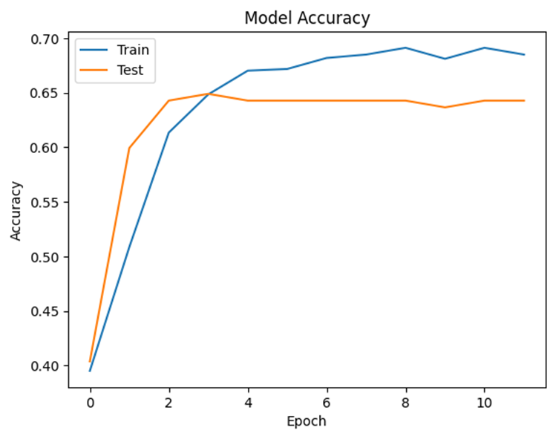
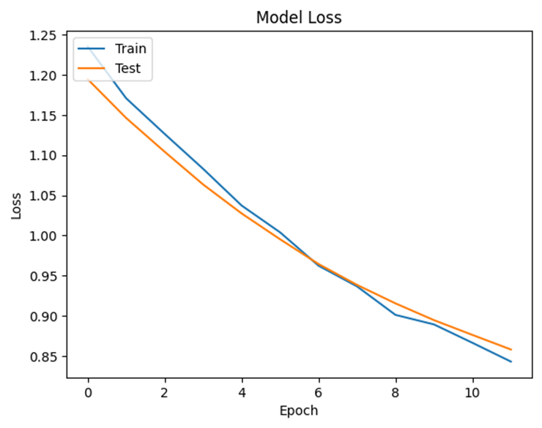
Model Training:
We trained the model on the MedWork database for 10 years of operation: 2013-2023.
A total of 3856 protocols were selected for model training
Overall Accuracy: 0.6428571428571429

Slide 10
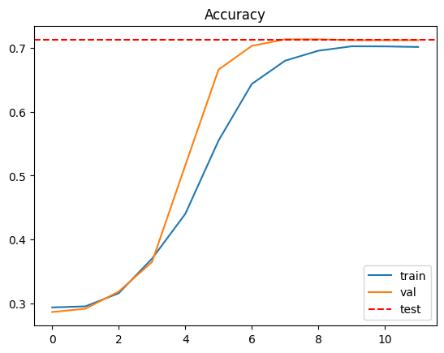
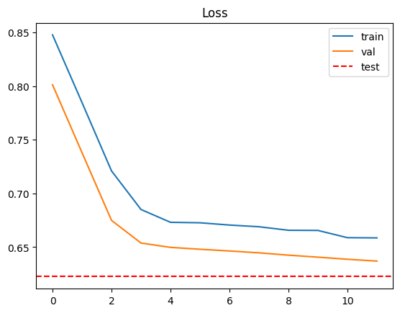
Model training with the addition of 4000 cryoprotocols:
Sensitivity: 0.6
Specificity: 0.66
PPV: 0.422680412371134
NPV: 0.8421052631578947
FPR: 0.5384615384615384
FNR: 0.18
Odds Ratio: 3.90476
Accuracy: 0.7438
Val_accuracy: 0.7370
TEST Accuracy 0.7126

Slide 11
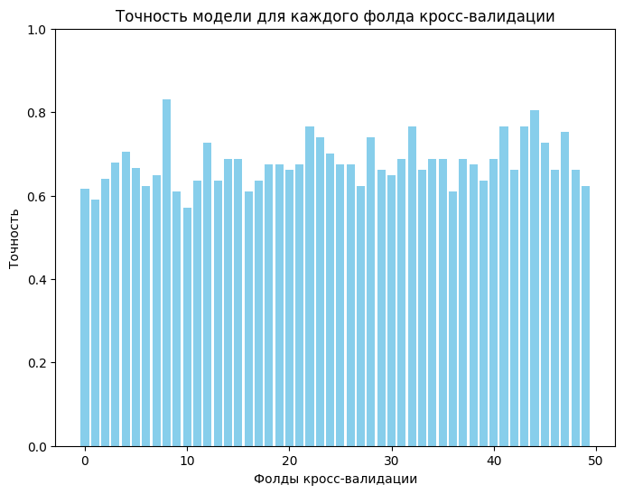
Model validation:
An analysis of model validation - running the model on 12 pseudo-randomly shuffled date frames subjected to sequential and independent analyses - found the model to be specific 85% of the time, with false positive predictions (FPR) in 15.5% of the time and an average ability to correctly predict the occurrence of clinical pregnancy (PPV) in 77% of the time.
We analysed how often the model correctly predicts the probability of clinical pregnancy on 1600 protocols - its accuracy is 76% with 86% completeness in describing this class of pregnancy
A cross-validation was performed for the neural network model using scikit-learn and Keras to evaluate the model on 50 different data splits (folds).
Different combinations of training and test sets were used in the cross-validation, which provides a better and more reliable assessment of the model performance:
Average accuracy: 0.6789876782894134 Standard deviation of accuracy: 0.07640754
Maximum accuracy: 0.8311688303947449

Slide 12
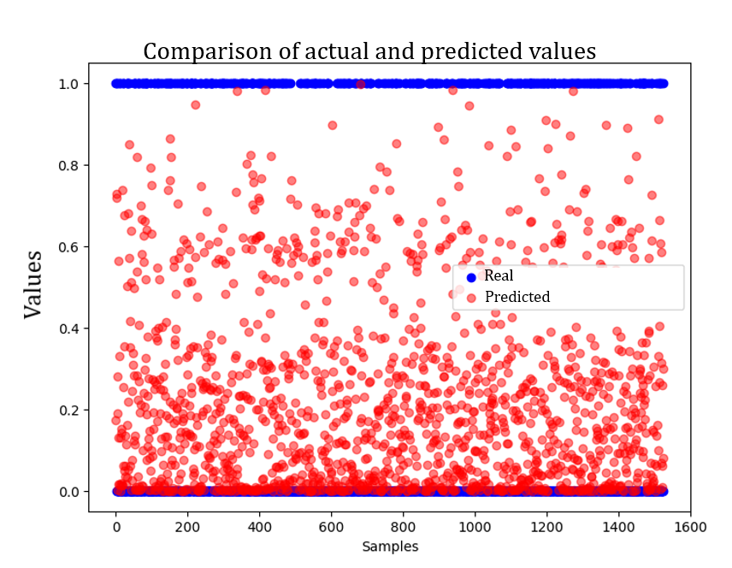
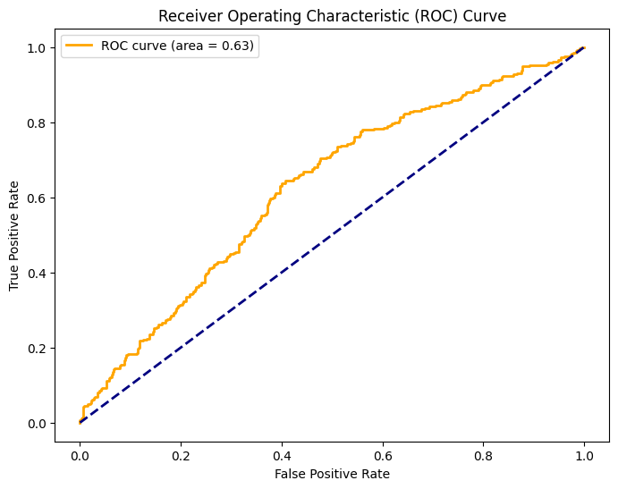
Model errors analysis:
We analysed the erroneous predictions of the developed model - ROC analysis
An AUC plot was constructed to assess the quality of the binary classification:
The ratio between the proportion of the occurrence of clinical pregnancy out of the total number of transfers correctly classified as resulting in clinical pregnancy and the proportion of the occurrence of clinical pregnancy out of the total number of transfers not carrying the sign of clinical pregnancy in their outcome, misclassified as carrying such a sign.
Mean AUC-ROC: 0.63; SD = 0.058

Slide 13
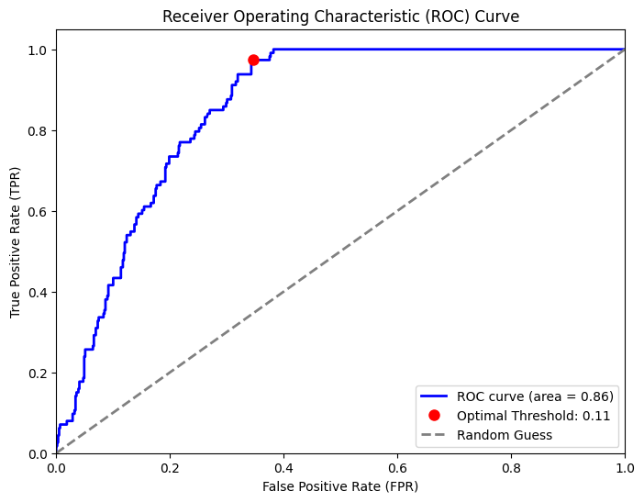
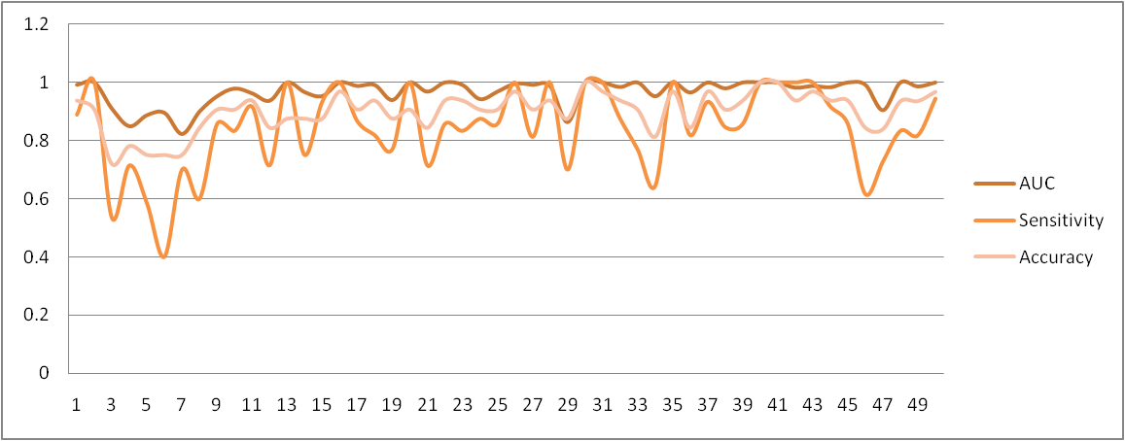
Model fitting on data from 2018:
Model accuracy on test data: 0.8418803215026855
Mean AUC-ROC after applying logistic regression:
0.86; SD = 0.061

Slide 14
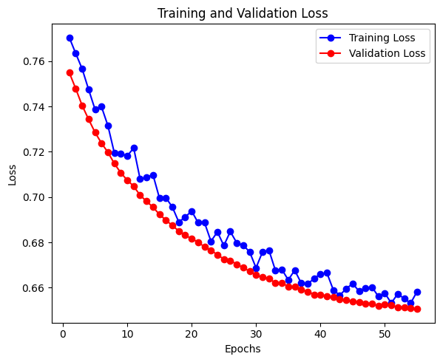
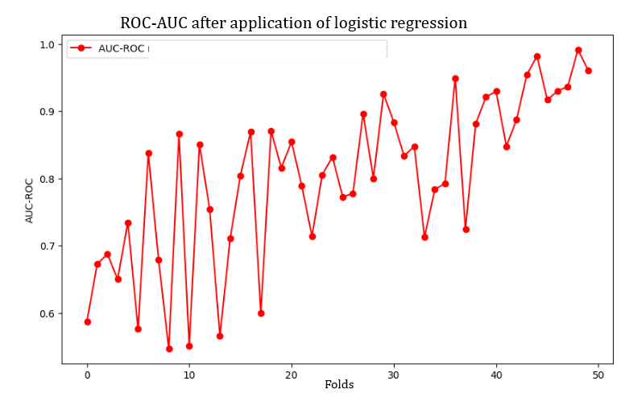
Using logistic regression to generalise model predictions on cross validation
Metrics: | AUC | Sensitivity | Specificity | PPV | NPV | FPR | FNR | Accuracy
 | 0,849 | 0,714 | 0,833 | 0,769 | 0,789 | 0,167 | 0,286 | 0,781
 | 0,888 | 0,583 | 0,850 | 0,700 | 0,773 | 0,150 | 0,417 | 0,750
 | 0,895 | 0,400 | 0,909 | 0,667 | 0,769 | 0,091 | 0,600 | 0,750
 | 0,823 | 0,700 | 0,773 | 0,583 | 0,850 | 0,227 | 0,300 | 0,750
 | 0,864 | 0,700 | 0,955 | 0,875 | 0,875 | 0,045 | 0,300 | 0,875
Mean | 86,37% | 61,95% | 86,39% | 71,88% | 81,13% | 13,61% | 38,05% | 78,13%
SD | 0,024 | 0,109 | 0,057 | 0,090 | 0,039 | 0,057 | 0,109 | 0,044

Slide 15
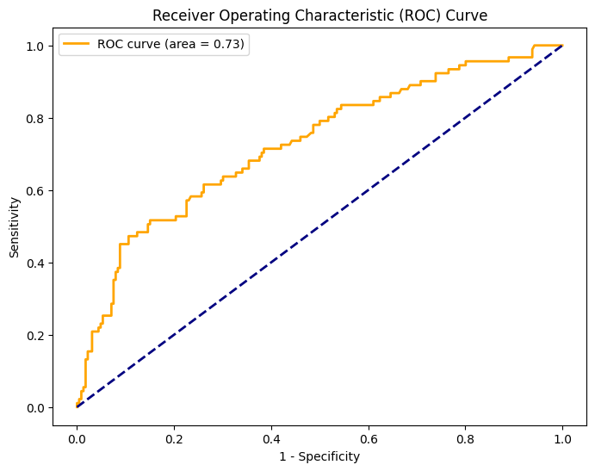
External validation
49662 embryos, 6240 protocols, real PR 28.43%, Predicted_PR 26.09% (p-value: 0.2185)
Accuracy: 0.70
Precision: 0.47
Recall: 0.44
F1 Score: 0.45
Odds Ratio: 3.0155913978494624
Test Accuracy: 76.34%

Slide 16
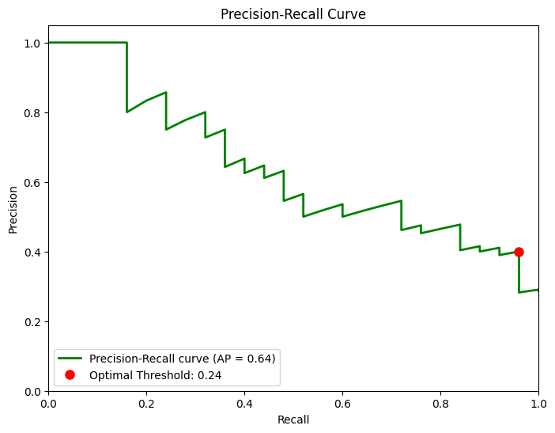
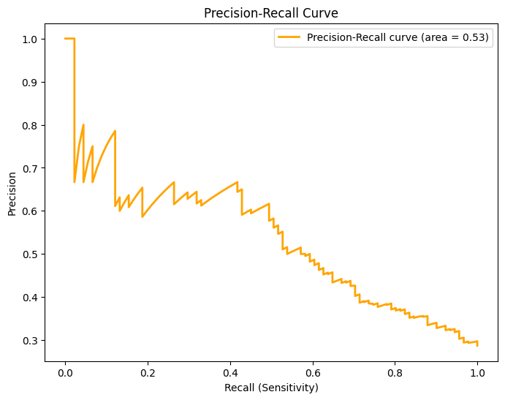
External validation and individual clinic model Precision
Accuracy: 52.97%
Precision: 58.25%
Recall: 46.88%
F1-score: 51.95%
Odds Ratio: 1.33
Accuracy: 0.70
Precision: 0.47
Recall: 0.44
F1 Score: 0.45
Odds Ratio: 3.02

Slide 17
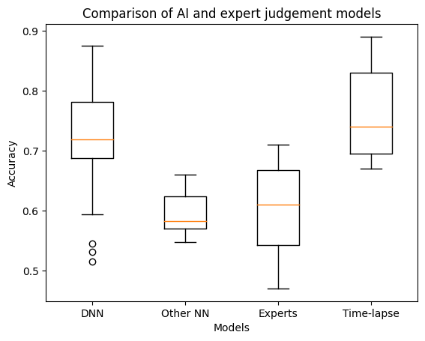
Comparison with expert judgement and Time-lapses
Mann-Whitney U Neural Network VS Other Models - Statistic: 230.0, p-value: 0.002
Mann-Whitney U Neural Network VS Experts - Statistic: 443.0, p-value: 0.0001
Mann-Whitney U Neural Network VS Time-Lapse - Statistic: 145.0, p-value: 0.471

Slide 18
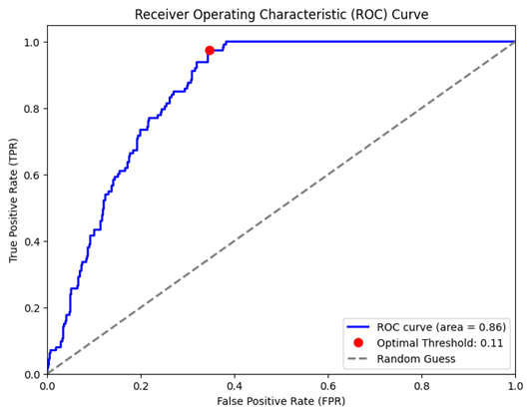
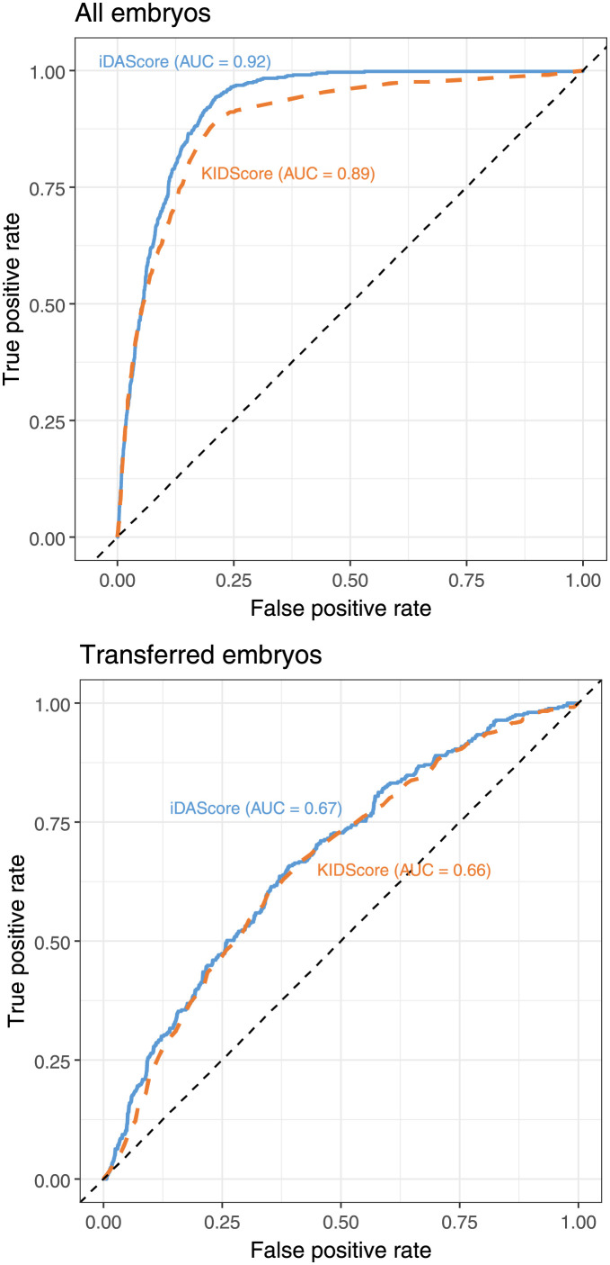
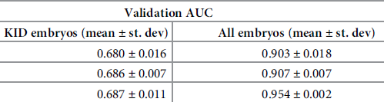
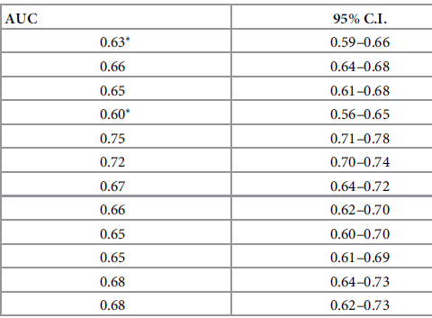
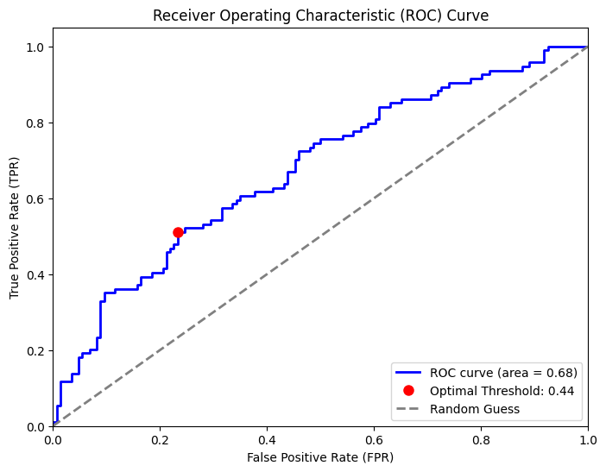
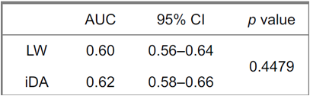
Comparison with KIDS Score & IDAScore Time-lapses
AUC-ROC 0.86; SD = 0.061
Berntsen et al., (2022)
No significant differences:
t-statistic: -0.74
p-value: 0.46
AUC-ROC: 0.68; SD = 0.054
Berntsen et al., (2022)
Shioya et.all ASRM 2023

Slide 19
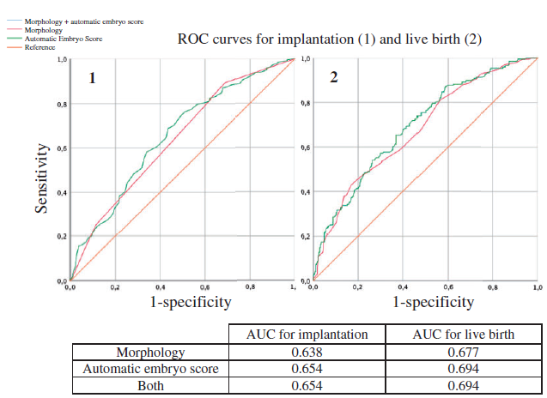
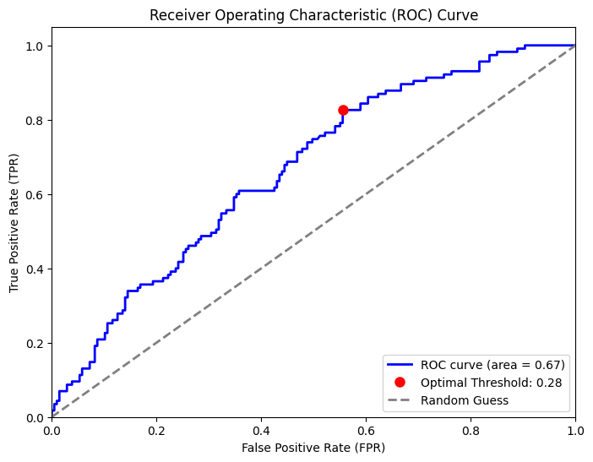
Comparison with KIDS Score & IDAScore V2 Time-lapses PGT
Bori, L., Meseguer, (2022) doi.org/10.1093/humrep/deac066
To identify the misprediction of pregnancy occurrence, data on pregnancy rates in protocols with PGT (and good quality euploid embryo transfer) in 1680 protocols were analysed. The error in predicting the occurrence of clinical pregnancy was 27%. AUC = 0.68 (0.75-0.62)

Slide 20
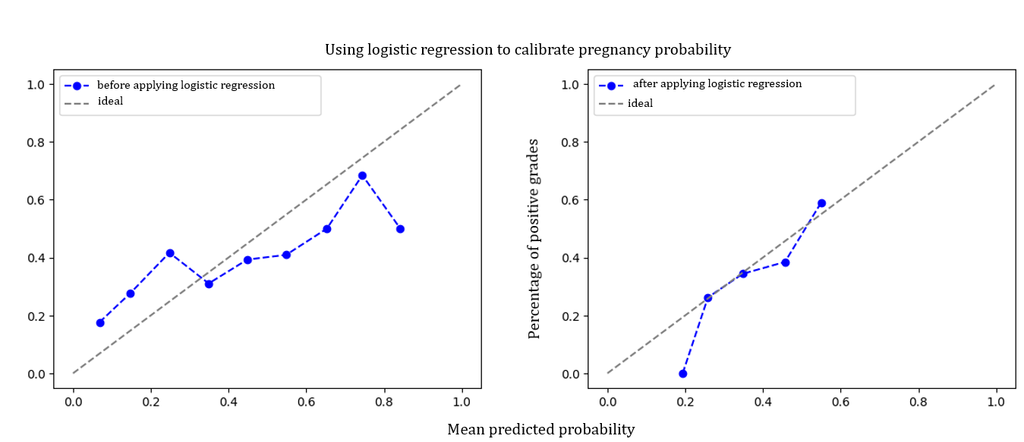
Using logistic regression to calibrate the probability of pregnancy occurrence
After training the neural network model, we use the probabilities obtained from it and apply logistic regression for calibration. Calibration is done using CalibratedClassifierCV from scikit-learn, which applies logistic regression to equalise the probabilities. In this way, we create a model that takes the outputs from the neural network and calibrates them, which improves the quality of the probability predictions.
In this way, both models play a role: the neural network is used to extract complex patterns from the data, and logistic regression is applied to calibrate the probabilities to make them more accurate and interpretable Odds Ratio = 6.66 (SD = 0.645)

Slide 21
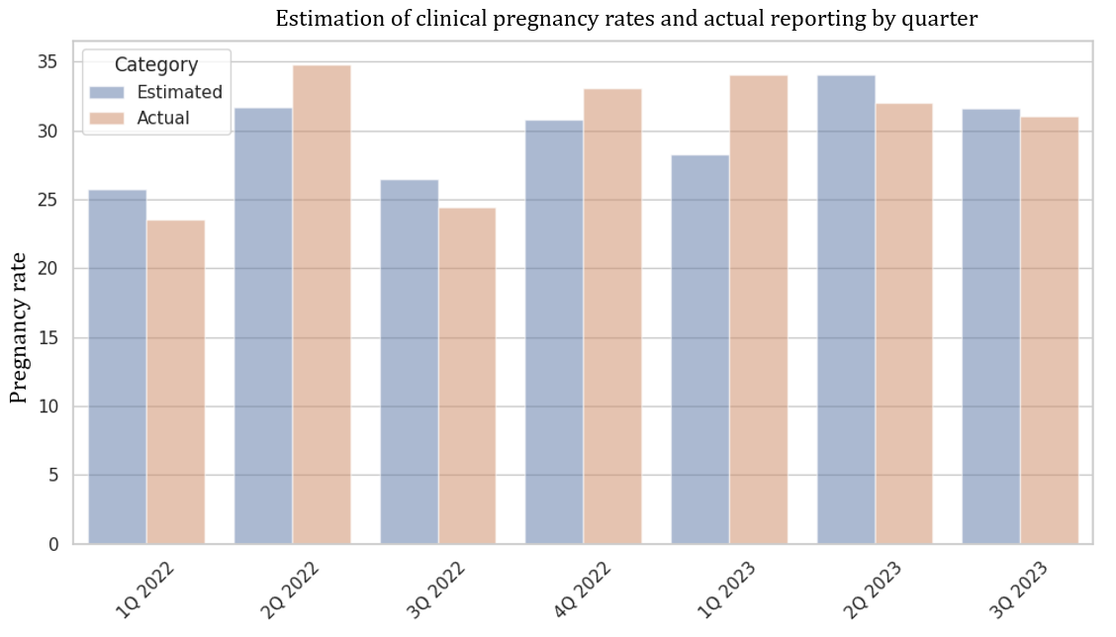
Results from the application of the model
When the model was validated on the 2022-2023 protocols, the successful prediction of the probability of no pregnancy was 86%. AUC = 0.86 (0.82-0.89)
U-statistic = 20.0, p-value = 0.62. The mean difference between the predictions obtained and reported as 2.56%.
Similar logistic regression model on clinical data: AUC = 0.6335(0.6202-0.6367) http://ivfpredict.com/
Nelson SM, Lawlor DA (2011)

Slide 22
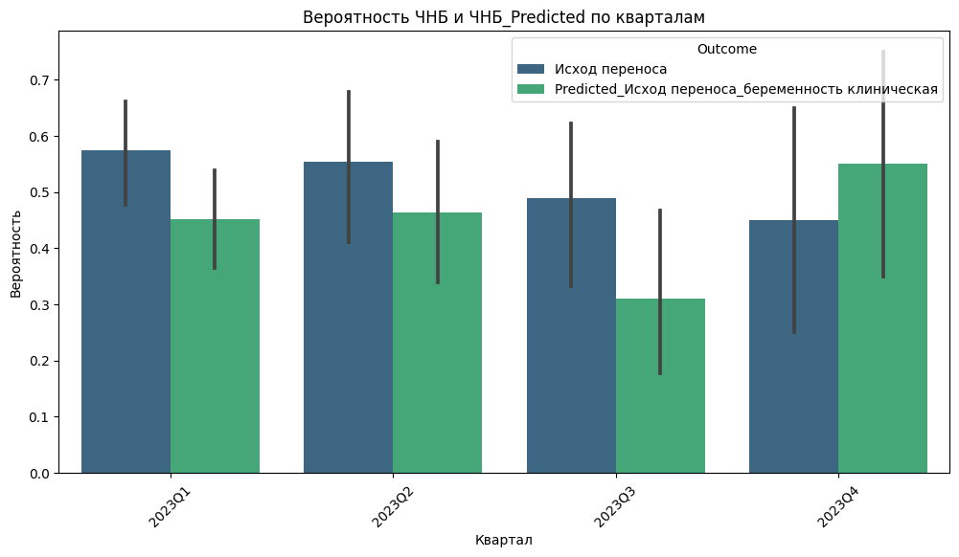
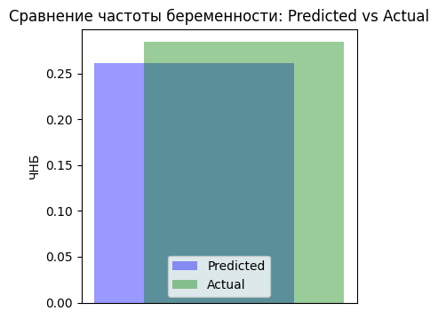
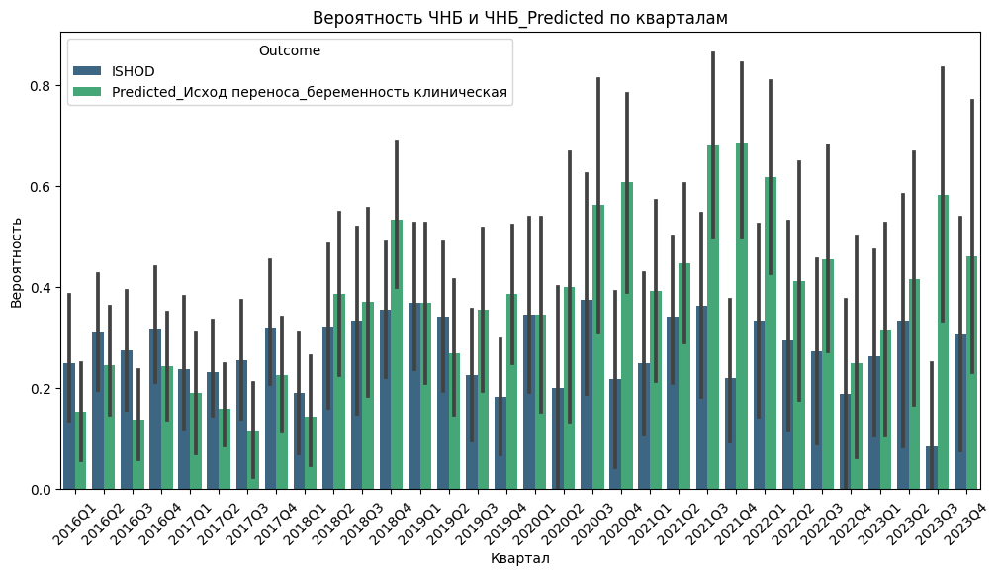
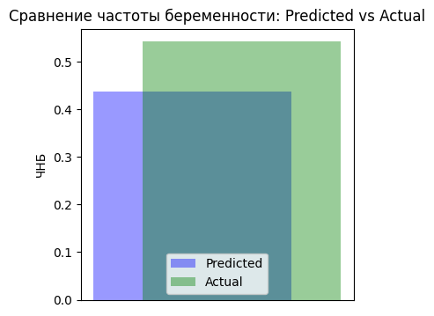
External validation of the model results
p-value: 0.3167
p-value: 0.2185

Slide 23
The results of applying the model in the form of a report:
Исход переноса | ПГД | День переноса | Перенесено эмбрионов | Заморожено эмбрионов | Частота оплодотворения | Частота дробления | Частота формирования BL | Частота формирования хороших BL | Частота получения ОКК | KPIScore | Predicted
беременность клиническая | 1 | 5 | 2 | 4 | 0.875 | 1 | 0.857143 | 0.571429 | 0.777778 | 25 | да
беременность не наступила | 1 | 5 | 1 | 0 | 1 | 1 | 0.428571 | 0 | 0.583333 | 13 | нет
беременность не наступила | 1 | 5 | 1 | 0 | 0.625 | 1 | 0.2 | 0 | 0.75 | 15 | нет
беременность клиническая | 1 | 3 | 1 | 2 | 0.533333 | 1 | 0.25 | 0 | 0.913043 | 15 | да
беременность не наступила | 1 | 6 | 3 | 0 | 1 | 1 | 0.714286 | 0 | 0.75 | 13 | да
беременность не наступила | 1 | 5 | 1 | 0 | 1 | 1 | 1 | 0 | 0.75 | 9 | нет
беременность не наступила | 1 | 3 | 1 | 0 | 0.571429 | 1 | 0 | 0 | 0.888889 | 11 | нет
беременность не наступила | 1 | 3 | 2 | 0 | 0.8 | 1 | 0.25 | 0 | 1 | 13 | нет
беременность не наступила | 1 | 6 | 1 | 0 | 0.666667 | 1 | 0.5 | 0 | 0.6 | 9 | нет
беременность не наступила | 1 | 3 | 2 | 0 | 1 | 0.666667 | 0 | 0 | 0.714286 | 11 | нет
беременность не наступила | 1 | 3 | 1 | 0 | 1 | 1 | 0 | 0 | 0.75 | 11 | нет
беременность не наступила | 1 | 6 | 2 | 0 | 1 | 1 | 0.8 | 0 | 1 | 11 | нет
беременность клиническая | 1 | 3 | 1 | 1 | 0.333333 | 1 | 0 | 0 | 0.571429 | 9 | нет
беременность не наступила | 1 | 3 | 2 | 0 | 0.666667 | 1 | 0 | 0 | 1 | 17 | нет
беременность не наступила | 1 | 5 | 1 | 0 | 0.333333 | 1 | 0 | 0 | 1 | 11 | нет
беременность не наступила | 1 | 3 | 1 | 0 | 1 | 1 | 0 | 0 | 0.5 | 9 | нет
беременность не наступила | 1 | 3 | 2 | 0 | 0.555556 | 0.8 | 0.2 | 0 | 1 | 15 | нет
беременность не наступила | 1 | 6 | 1 | 0 | 0.875 | 1 | 0.571429 | 0 | 1 | 17 | да
беременность не наступила | 1 | 5 | 2 | 0 | 0.666667 | 1 | 0.5 | 0 | 1 | 9 | нет
беременность не наступила | 1 | 3 | 1 | 0 | 1 | 1 | 0 | 0 | 0.5 | 13 | да
беременность клиническая | 1 | 5 | 1 | 2 | 0.625 | 1 | 0.8 | 0.4 | 0.818182 | 19 | да
беременность клиническая | 1 | 5 | 1 | 1 | 1 | 1 | 1 | 0.666667 | 1 | 13 | да
беременность клиническая | 1 | 5 | 2 | 0 | 0.75 | 1 | 1 | 0.333333 | 0.666667 | 17 | да
беременность не наступила | 1 | 3 | 1 | 0 | 0.428571 | 1 | 0 | 0 | 1 | 13 | нет
беременность не наступила | 1 | 2 | 1 | 0 | 0.25 | 1 | 0 | 0 | 0.857143 | 7 | нет

Slide 24
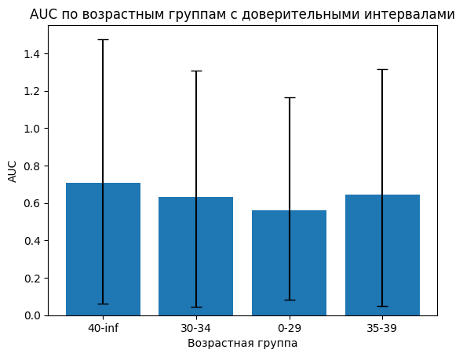
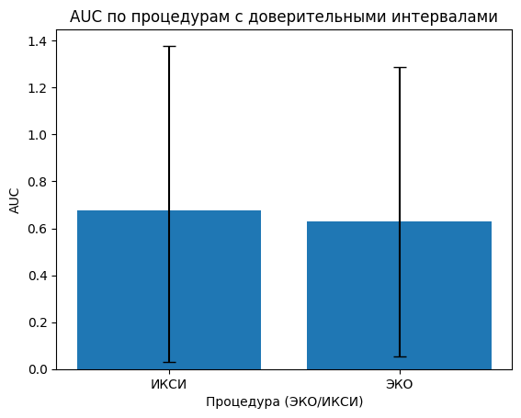
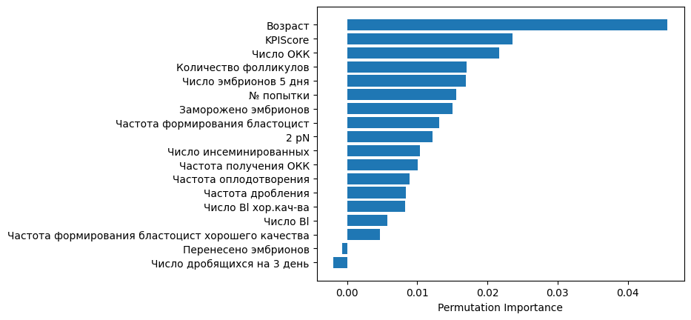
Comparison of AUC for different ages and fertilisation methods

Slide 25
Applications of the model:
It is possible to analyse in detail only selected protocols with pregnancy failures and at the same time have a working system for real-time evaluation of laboratory KPIs.
The developed model monitors KPIs to evaluate the performance of individual embryologists and culture conditions. Inconsistencies in which can be detected in the model report and used to provide systematic and early detection of adverse outcomes and clinically significant changes in laboratory performance indicators.
Data on the accuracy of prediction of the outcome of the model report is superior to the similar accuracy of prediction of transfer outcome from experienced embryologists based on clinical and laboratory parameters - 51% (range 43-59%), which allows its application for remote monitoring of the performance of the ART department and use it as an effective mechanism of the system of general quality control of the clinic.
The developed neural network has sufficient predictive power to analyse IVF protocols. It can be used both for retrospective analyses of performance and for prospective assessment of the chances of clinical pregnancy and is promising in terms of assisting in medical decision-making.
The model can be used as a tool to monitor the quality of performance and success of IVF programmes. It provides an indication of cases in which transfer should have resulted in pregnancy, if the expected and actual pregnancy rates do not match - there are good reasons to identify factors preventing implantation. On the laboratory side, it takes into account KPIs, the values of which are automatically calculated by the model, and on the clinical side, it compares the actual pregnancy rate with the theoretically calculated one.
The developed deep learning neural network model has successfully passed all validation tests, has comparable abilities with AI systems used in ART to correctly predict the chance of clinical pregnancy in a particular IVF protocol and the cumulative incidence of PND over a selected period of time, and has the ability to track laboratory KPIs and their impact on transfer outcomes in detail.

